Slide 1





STAT605 Final Project
NYC Real-Time Traffic Speed Analysis
Overspeed Rate and Jam Rate Analysis
Reporter: Zhengda Liu, Eva Song
Shengyao Ye, Jingwei Zhang
Tianle Qiu

Slide 2

PART 01
Project Introduction

Slide 3
Constellation
Project Introduction
01 Research Background
Our dataset (24GB) contains real-time traffic information from the five boroughs of
New York City which provides a solid foundation for analyzing urban traffic patterns.
02 Research Objectives
The aim of this research is to identify which streets in New York City experience
higher levels of jam and overspeed. By employing CHTC and statistical
analysis, we seek to offer actionable recommendations for drivers and
policymakers. Additionally, we aim to uncover traffic patterns that can
inform potential improvements.
03 Research Outcomes
We will conduct clustering analysis, complemented by the
development of an interactive visualization tool using ShinyApp.
This tool will dynamically display traffic conditions for different streets
at various times, presenting results in a map-based format for intuitive
understanding and decision-making support.
Research Objectives
01
02
03
Research Background
Research Outcomes

Slide 4
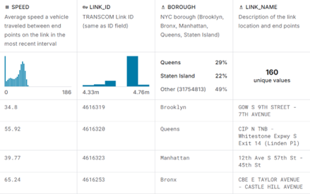

Constellation
Data Description
Link_name: The names of the streets.
Borough: The name of the NYC boroughs.
Link_id:
The basis for us to divide
several small data sets.
Speed: The average speed between end points.

Slide 5
PART 02
Data processing

Slide 6
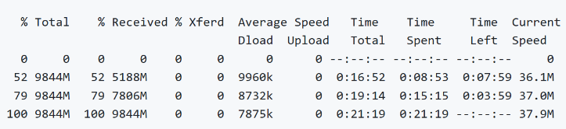
Data downloading
1.[Kaggle NYC real-time traffic speed data]
Download method:Use `curl` command to download the zip archive (`archive.zip`), the size is 9844M, the download time is about 22 minutes.
Decompress: Recommend 7z x archive.zip -o./7z/ ,which provides decompression progress, more efficient!

Slide 7
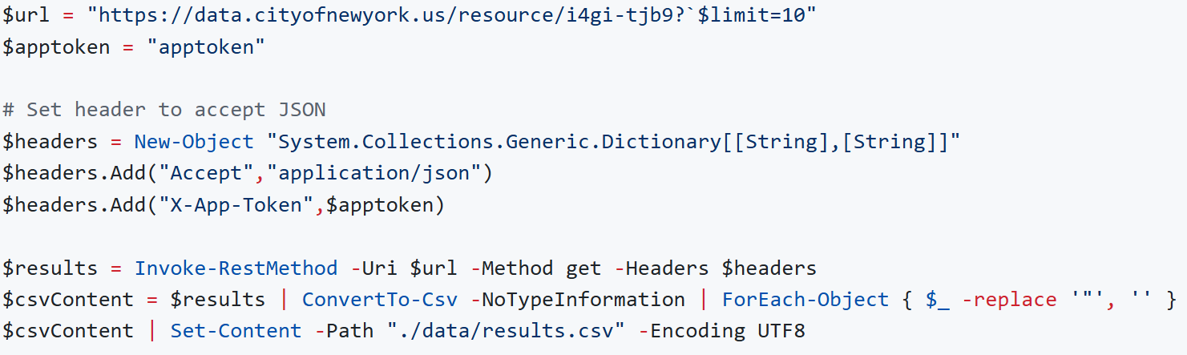
Data downloading
2.[NYC Open Data]
Download method:
Python: Recommended Batch Download
Grab the data in batches and save them as multiple CSV files (word downloads time out due to excessive data volume)
PowerShell: Use Invoke-RestMethod command to grab JSON data and convert to CSV.
Bash: Use curl with jq to process JSON data and save to CSV file.

Slide 8
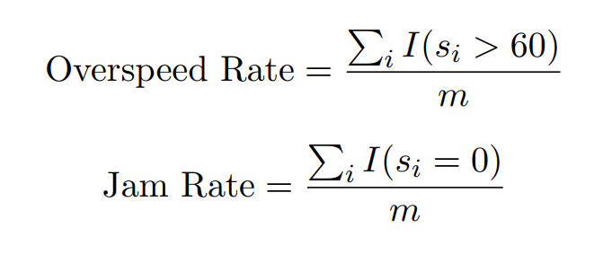
Data cleaning & Formulas
Steps:
Definition
Load merged csv file
Convert datetime object as.POSIXct
Remove invalid latitude and longitude data
Extract all street names for users select
m is the number of cases in this file.
s_{i} is the speed of the i_{th} case in this file.

Slide 9


CHTC
Summary Stats
for Every Link
Split Data By Months
For Map Visualization
File Splitting
according to link (“Link_ID”)
File Splitting
according to time period
1. Split large files to save time and memory.
01
…
…
Data Cleaning
(remove “Status”==-101)
In parallel
In parallel
Statistics Calculation
(calculate avg. speed)
Statistics Calculation
(jam rate & overspeed rate)
…
2. Handle files in parallel to improve efficiency.
…
20Jan.csv
20Feb.csv
20Mar.csv
02
File Merging
Merge the statistics
summary_results.csv

Slide 10
PART 03
Results

Slide 11
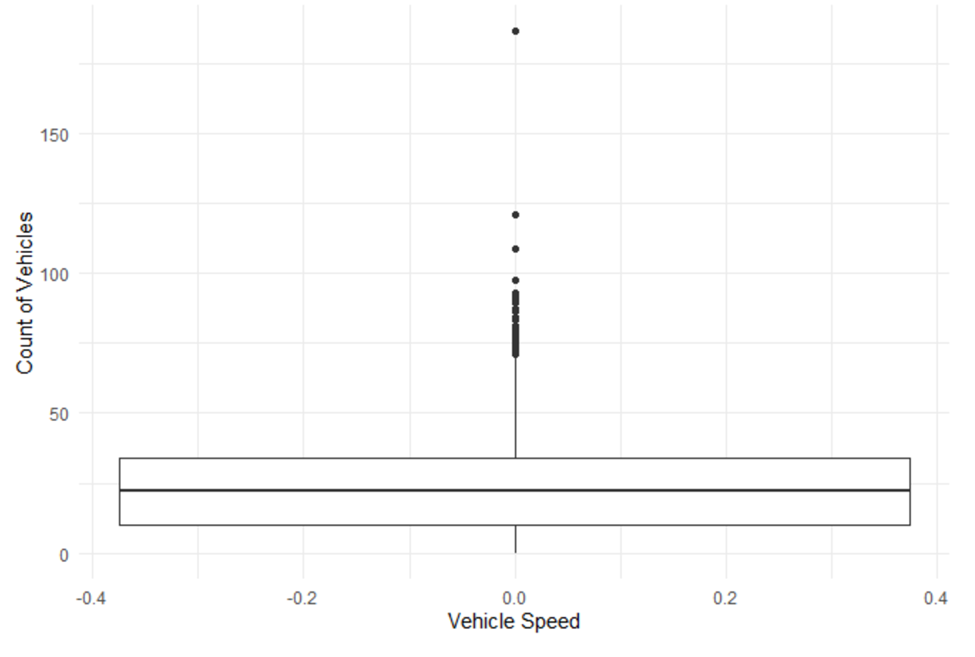
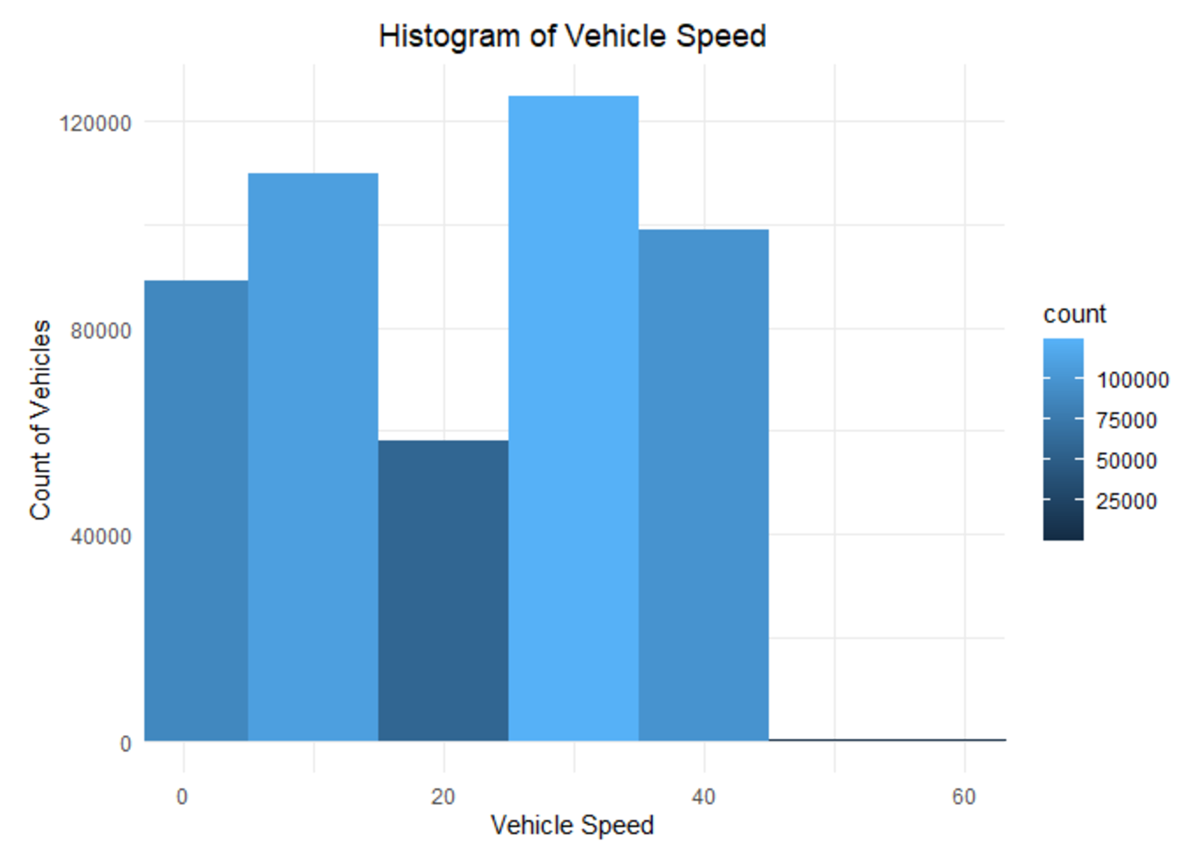
Processing Outliers and Histogram Visualization
Figure: Boxplot of Vehicle Speed
Figure: Histogram after moving outliers

Slide 12
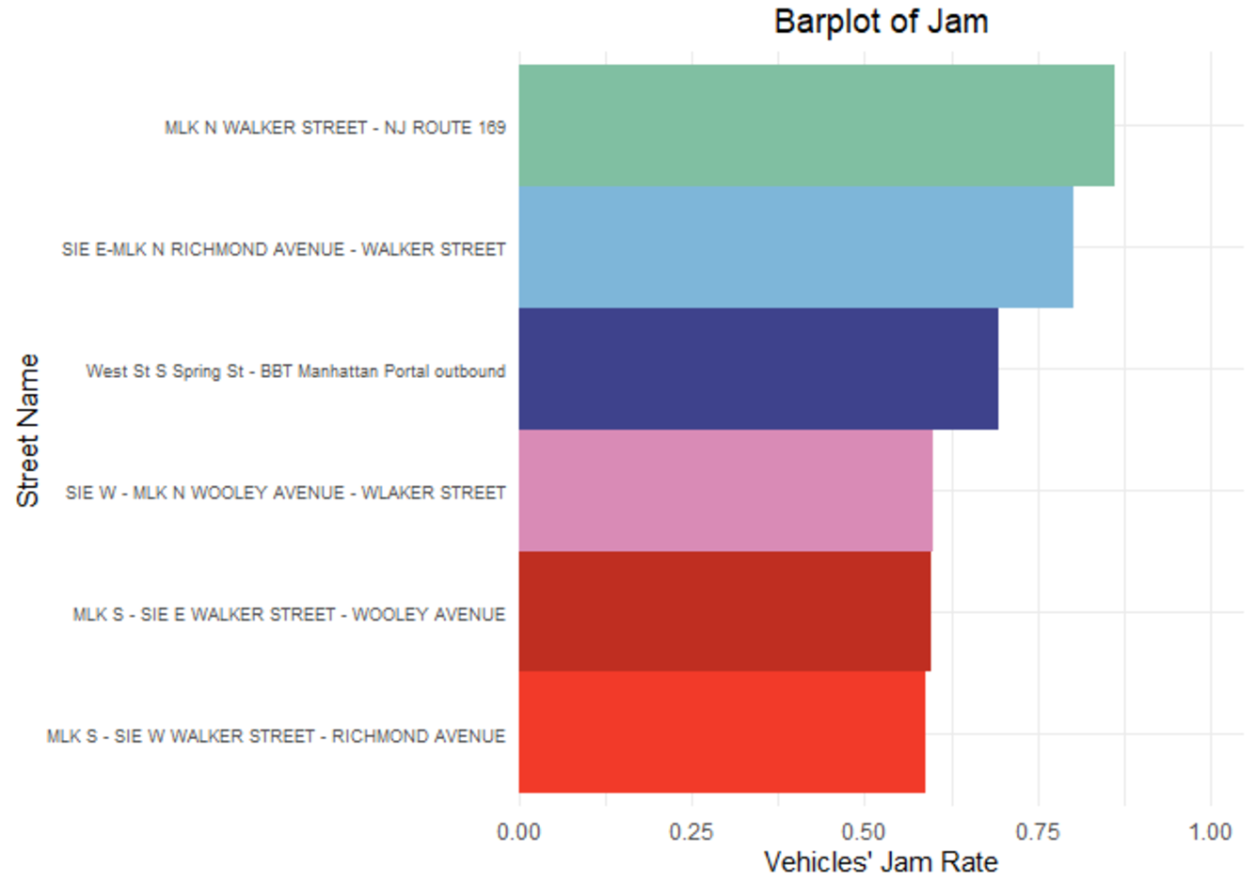
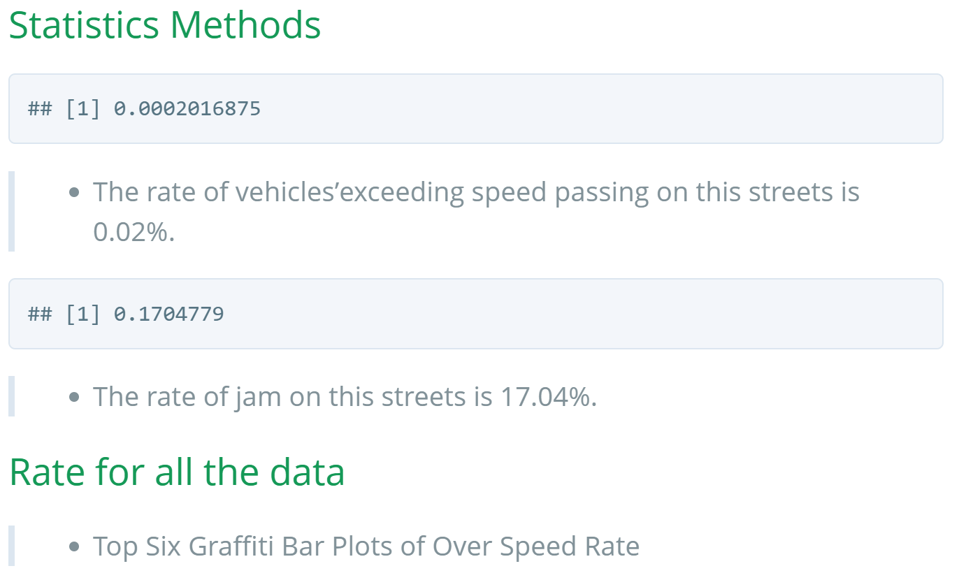
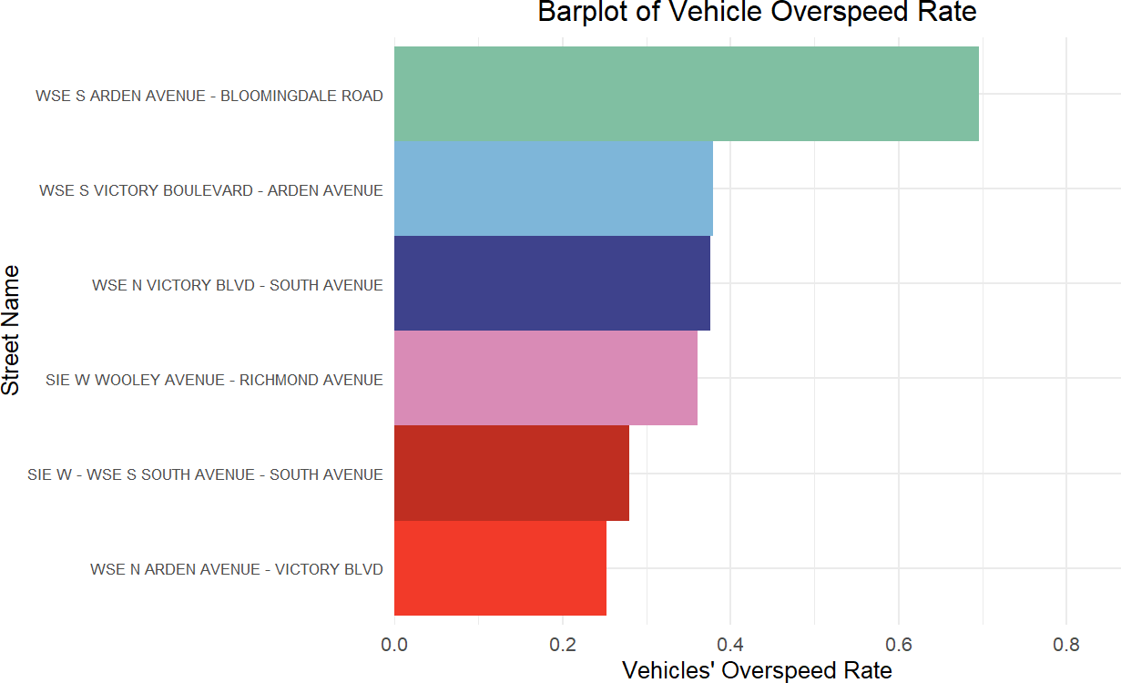
Result
Figure: Jam Rate
Figure: Overspeed Rate

Slide 13
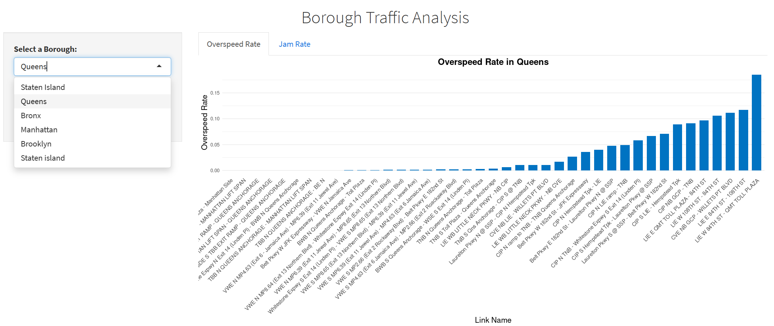
Visualization
Firstly, we use shinyapp to visualize the bar plots of overspeed rates, jam rates in different boroughs.
https://zdliu0205.shinyapps.io/Visualization_v3/

Slide 14
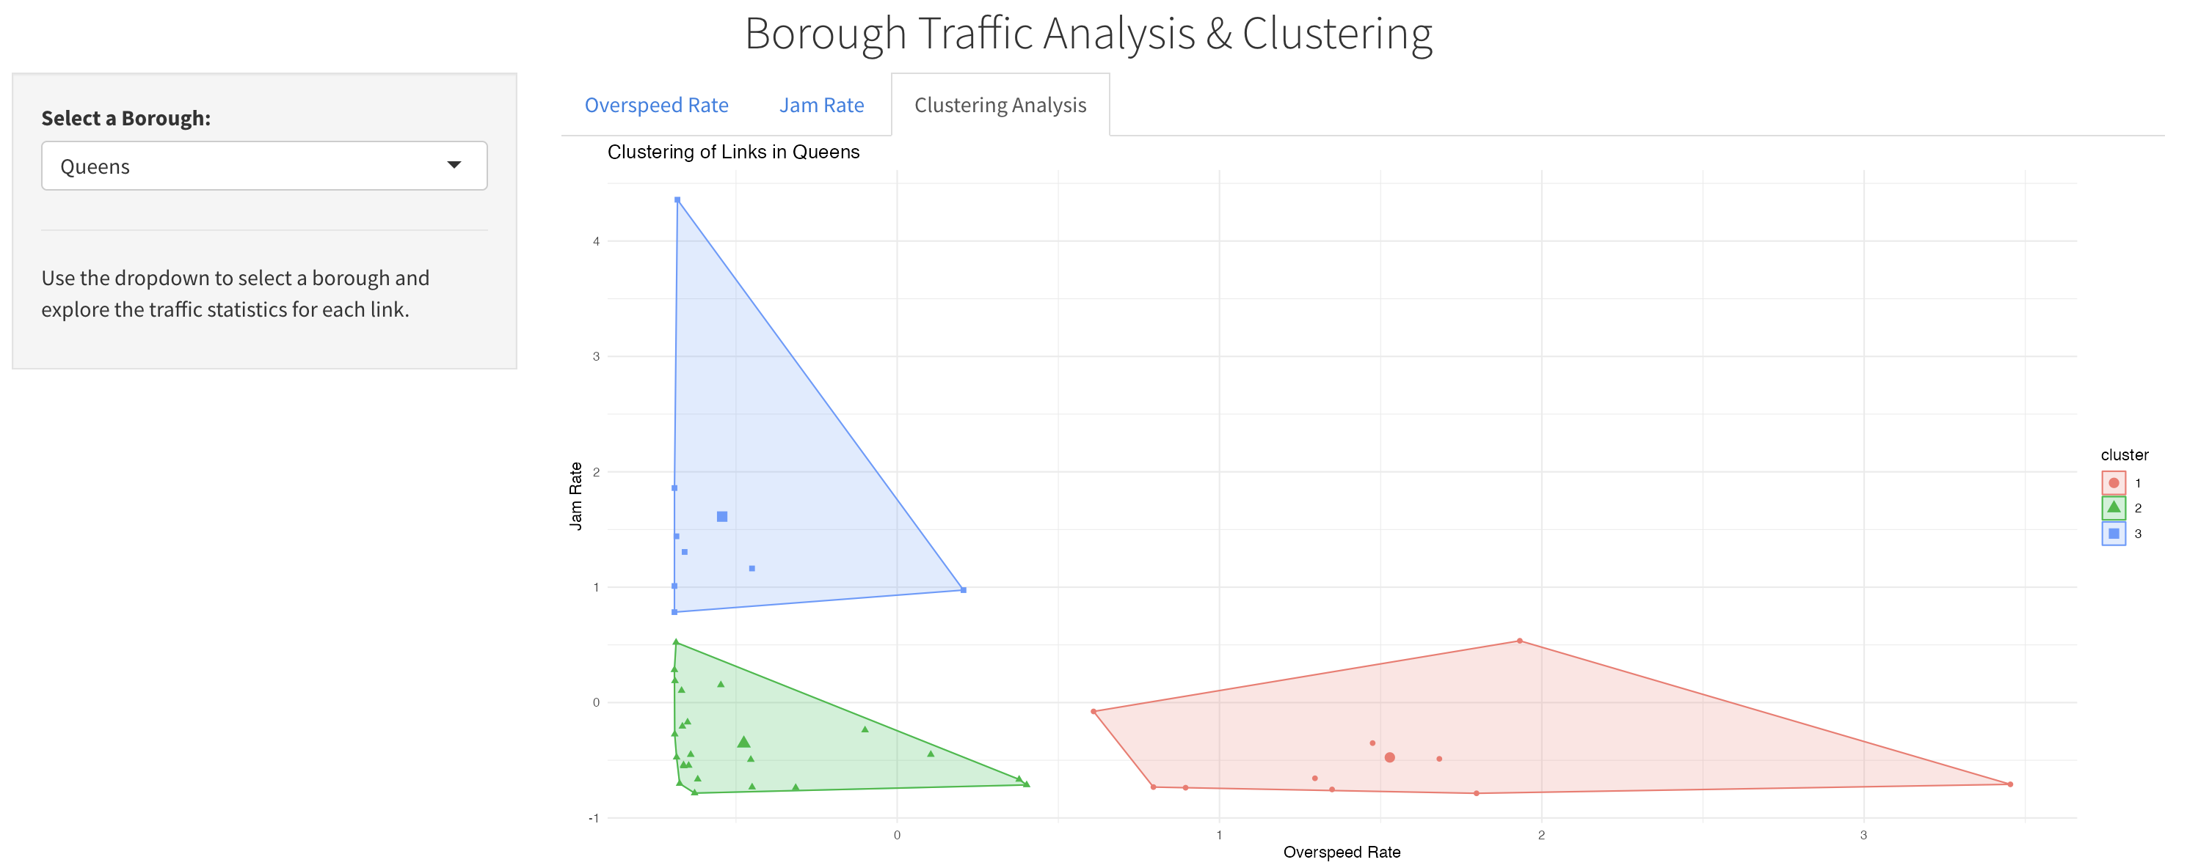
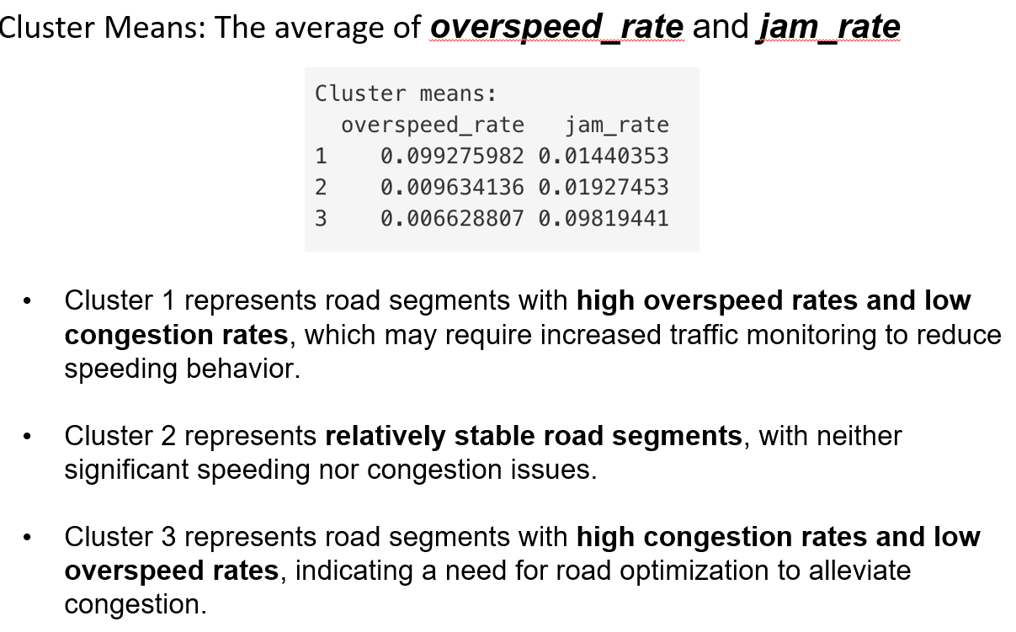
K-means Clustering Analysis & Visualization
Then, overspeed rate and jam rate were used for cluster analysis of different link_name to
find out the road sections with similar traffic patterns.
We believe this can help authorities understand which roads have similar traffic characteristics.

Slide 15
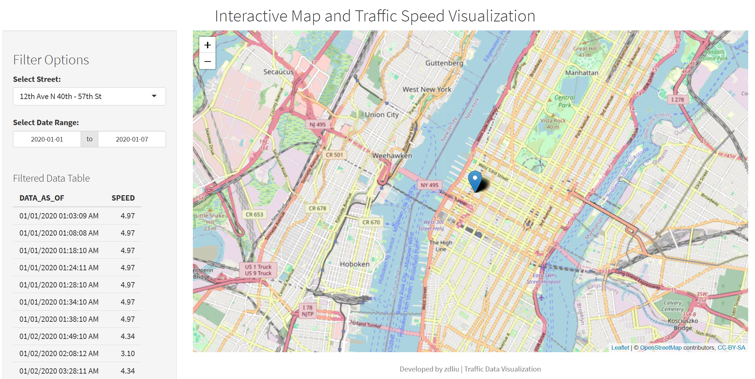
Visualization
We use Shinyapp to present an interactive map and traffic speed visualization. Users can select
NYC streets and date ranges to view locations on the map, with traffic speed displayed.
https://zdliu0205.shinyapps.io/street_map_visualization_try/

Slide 16
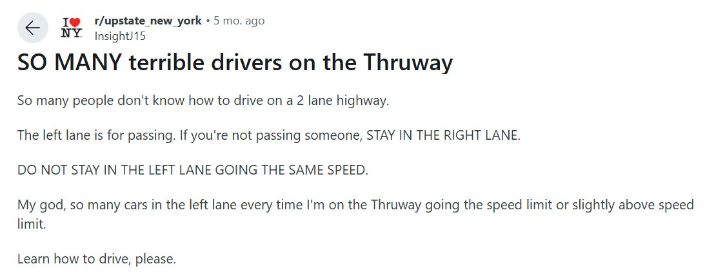
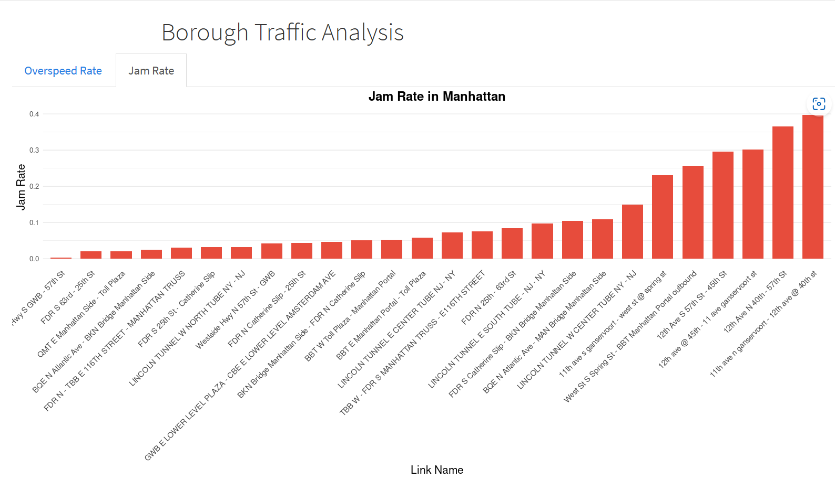
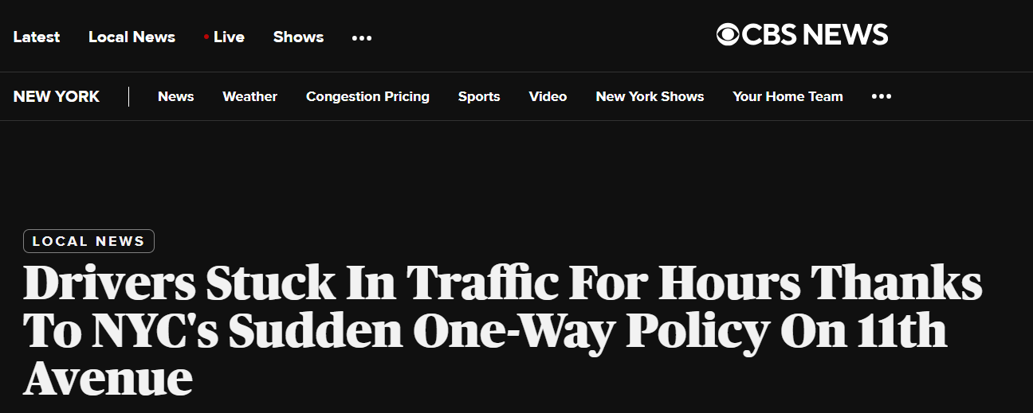
Validation of Data Analysis: Traffic Jam on 11th Avenue
This Reddit post below expresses frustration about traffic jams on 11th Ave, specifically caused by drivers
not following proper lane discipline. Moreover, a policy change reported by CBS News sheds light on a
major traffic jam issue on 11th Ave. In our visualization, 11th Ave shows the highest jam rate, which aligns
with the facts.
Despite the policy change, it may not have significantly improved traffic flow, reflecting either poor
enforcement or inadequate measures. The high jam rate seen in the visualization indicates that there may
be a need for further improvements in traffic management strategies.

Slide 17
Thank you !

